Slide 1
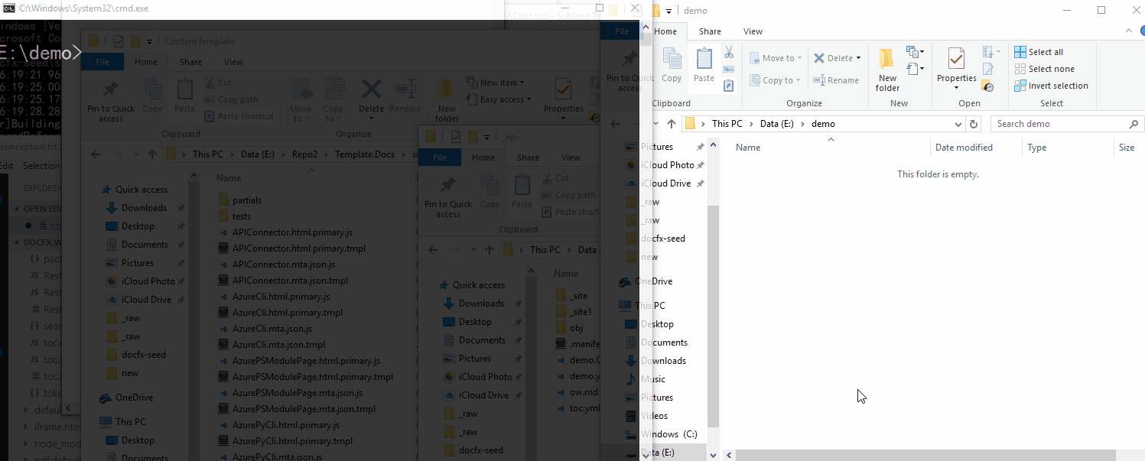
Introduction to DocFX
Liangying Wei

Slide 2
Agenda
Basic Introduction
Open Source
DocFX Walkthrough (DEMOs)
Inside DocFX
History
Lessons Learnt

Slide 3

Basic Introduction
Why call it DocFX
Inspired by CoreFX, stands for Document Frameworks
Codename: docfx
What does DocFX do
Generate documentation (website, PDF, …)
From Markdown files and source code
Open source
https://github.com/dotnet/docfx
701 Stars

Slide 4
Open Source
History
Community Involvements
Use cases

Slide 5
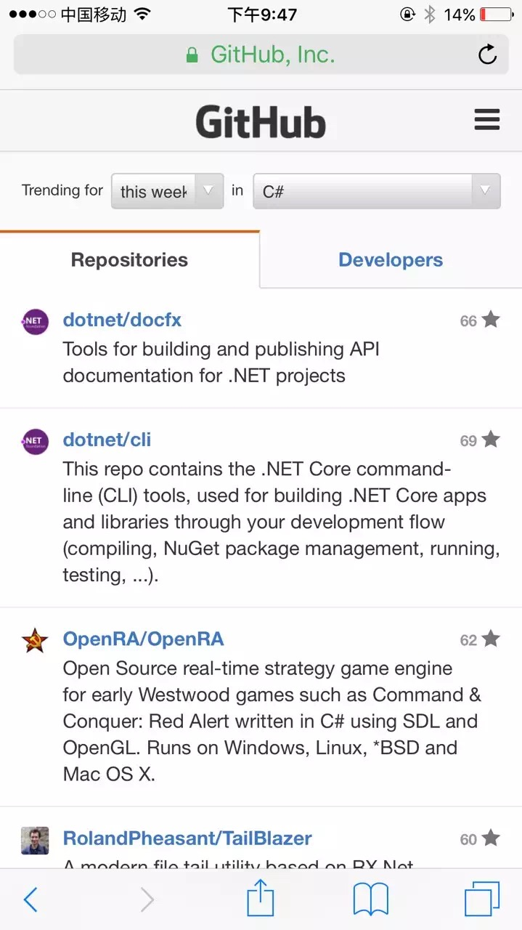
Open Source History
Start as a POC project DocAsCode
July 2015, change name to DocFX and join dotnet org
Dec 2015, open source
66 stars on 31th Dec. 2015
Top 1 C# Trending for this week in GitHub
June 2017, 700 stars

Slide 6
Open Source Involvements
701 Stars
40+ external contributors
~10 active contributors, issues, PRs, gitter.im
@jonskeet, @bitbonk, @dlech, @AustinWise, @pascalberger, @richardschneider, @ferventcoder, @agc93, …
Collect feedbacks from
Feethub.com: a feature upvoting system
Disqus.com: commenting system

Slide 7
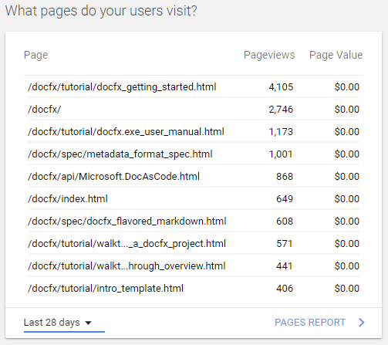
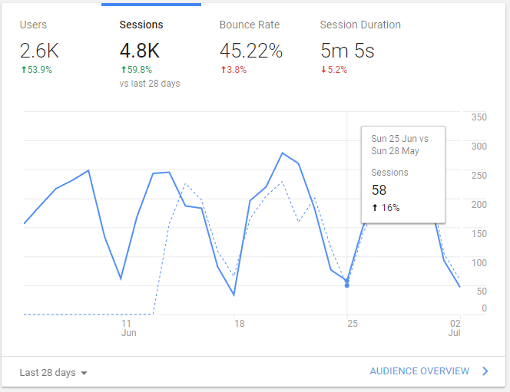
Homepage http://dotnet.github.io/docfx/
Generated by DocFX,
Google Analysis

Slide 8
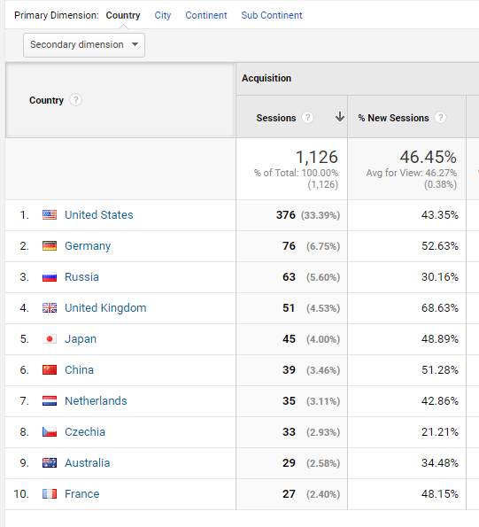
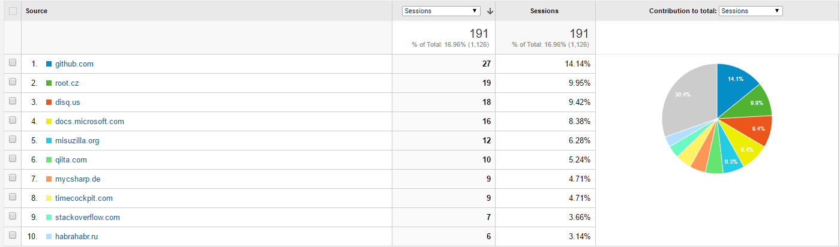
Geo

Slide 9
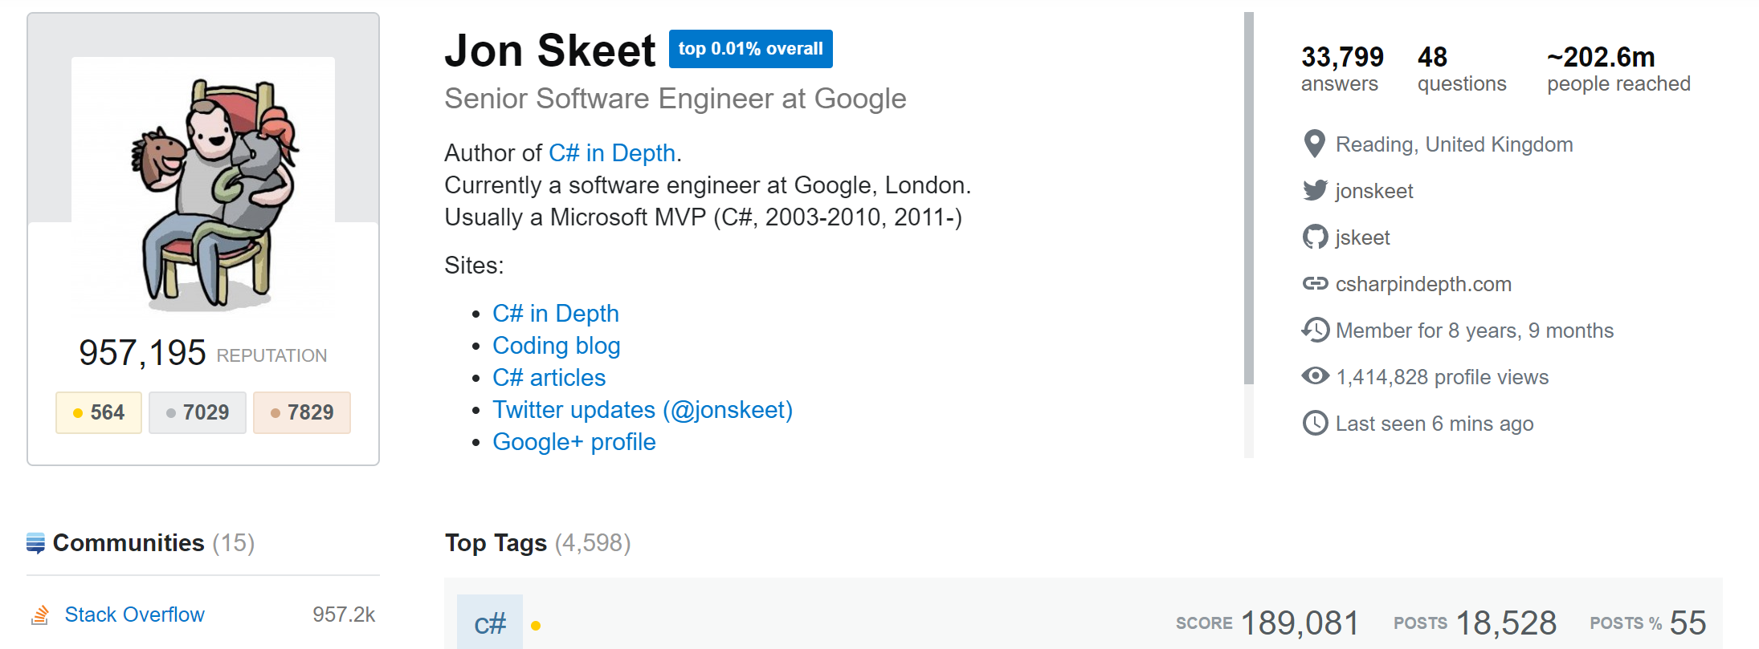
Use cases
Jon Skeet https://stackoverflow.com/users/22656/jon-skeet
Google Cloud Client Libraries for .NET https://googlecloudplatform.github.io/google-cloud-dotnet/docs/index.html
His personal project http://nodatime.org/

Slide 10
Use Cases
Mapbox Unity SDK https://github.com/mapbox/mapbox-unity-sdk
Web Applications UK Ltd Utilities http://webappsuk.github.io/CoreLibraries/ https://github.com/webappsuk/CoreLibraries/blob/master/ILMerge/ILMerge.cs/#L65
Small personal projects
Easy to start with

Slide 11
Use Cases
Source | Website
https://github.com/dlech/Dandy.Core | https://dlech.github.io/Dandy.Core/api/
https://github.com/SolidEdgeCommunity | https://github.com/SolidEdgeCommunity
https://github.com/vinhui/ModEnabler | http://modenabler.greenzonegames.com/
https://github.com/InstantQuick/AzureFunctionsForSharePoint | https://afspdocs.blob.core.windows.net/docs/index.html
https://github.com/NetOfficeFw/Docs | https://netoffice.io/
https://github.com/QualiSystems/Toscana
https://github.com/markvincze/Stubbery | http://markvincze.github.io/Stubbery/
https://github.com/Intelecom/direct-payment-client-dotnet | https://intelecom.github.io/direct-payment-client-dotnet/api/index.html
https://github.com/GenusAS | https://docs.genus.no/
Quick starters
Reuse default template
Change ICON

Slide 12
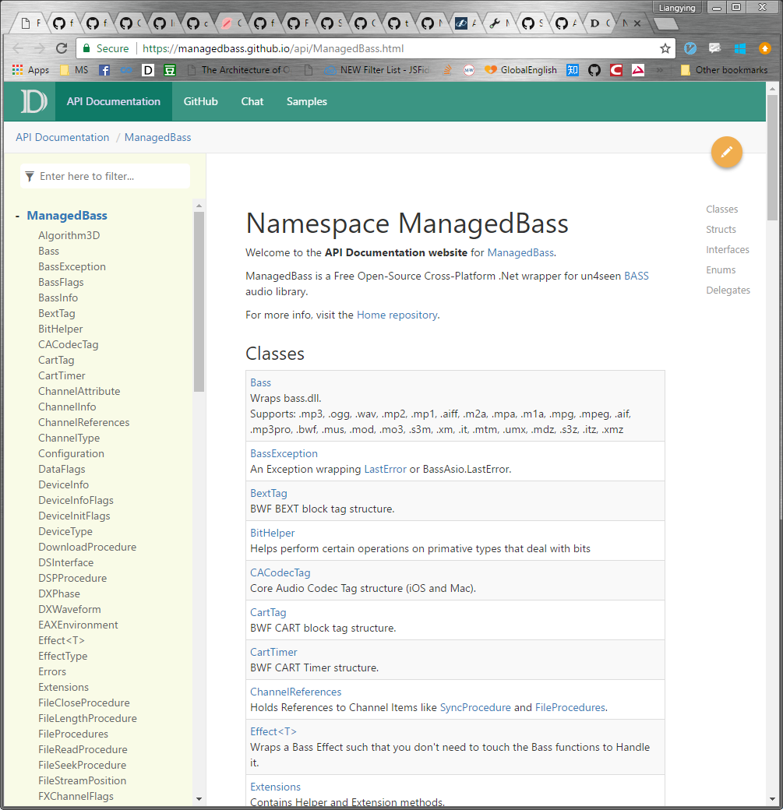
Use cases
Advanced users with custom templates
https://github.com/ManagedBass/Home https://managedbass.github.io/api/ManagedBass.html

Slide 13
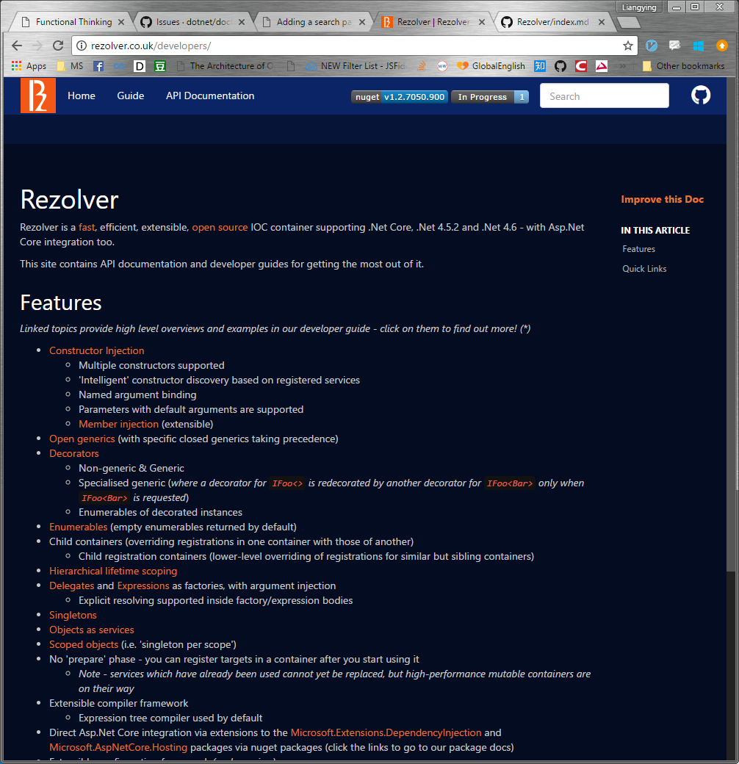
Use cases
Advanced users with custom templates
https://github.com/ZolutionSoftware/Rezolver http://rezolver.co.uk/developers/

Slide 14
Community Integrations
DocFX-Docker
Cake.DocFX
The DocFx Addin for Cake
VSTS DocFX integration
https://blogs.msdn.microsoft.com/premier_developer/2017/04/14/documentation-in-a-devops-world/
Debian package for DocFX
https://github.com/dlech/docfx-deb
FAKE(F# Make https://fake.build) wrapped DocFX
DocFX schema inside Visual Studio
http://json.schemastore.org/docfx
Visual Studio Code Preview extension
https://marketplace.visualstudio.com/items?itemName=docfxsvc.DocFXPreview

Slide 15


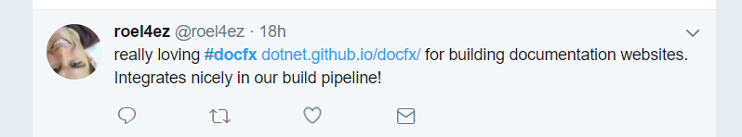
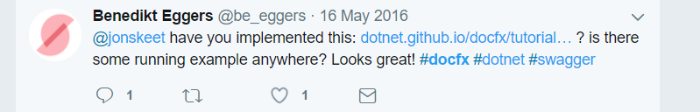


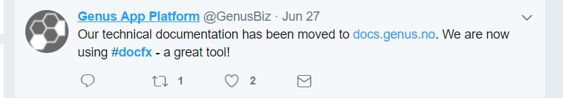

Social Media Interaction
Twitter @docfx #docfx

Slide 17
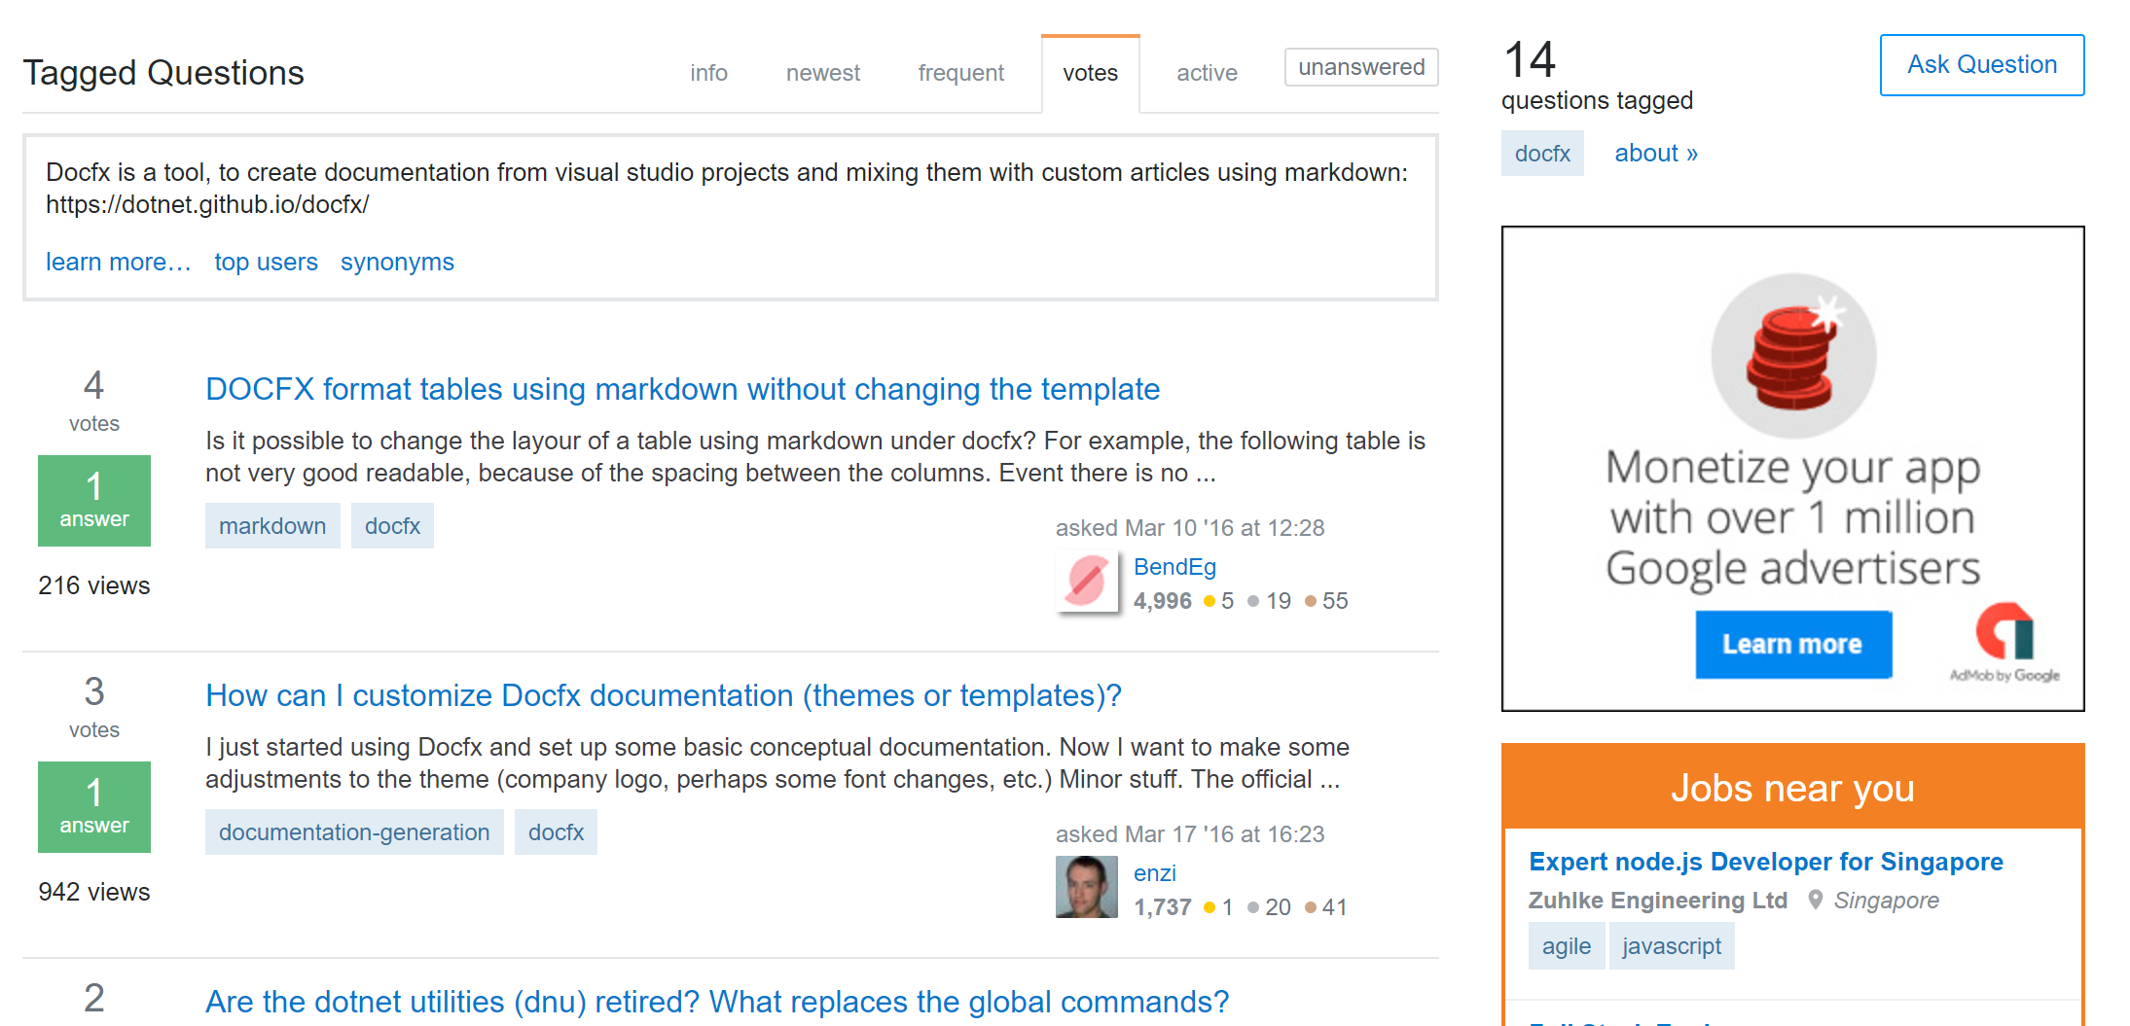
Social Media Interaction
StackOverflow https://stackoverflow.com/questions/tagged/docfx

Slide 18
DocFX Walkthrough (Demo)

Slide 19
Key features in DocFX
Website ⬄ source code
Rich Markdown syntax support
Cross reference
Overwrite document
File restructure
Multi-language support

Slide 20
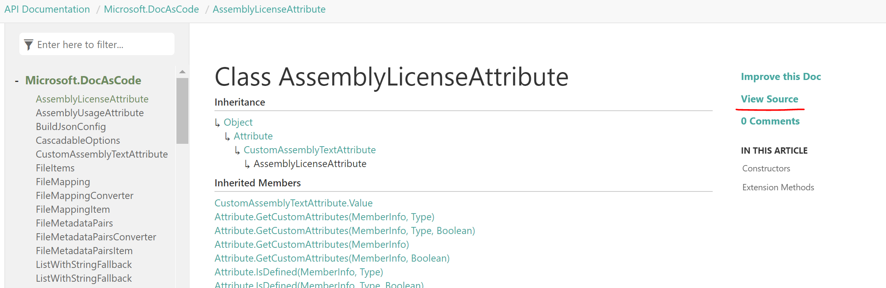
Website ⬄ Source code
Source code directly to website
Webpages can link back to source code
Especially useful for open source projects

Slide 21
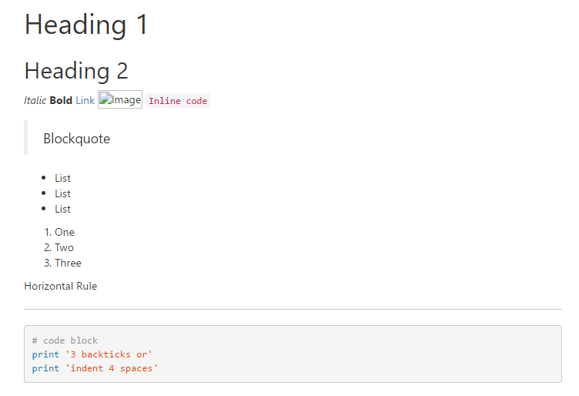
Markdown Syntax Support
# Heading 1
## Heading 2
*Italic* **Bold** [Link](http://a.com) ![Image](http://url/a.png) `Inline code`
> Blockquote
* List
* List
* List
1. One
2. Two
3. Three
Horizontal Rule
---
```
# code block
print '3 backticks or'
print 'indent 4 spaces'
```
Basic CommonMark support

Slide 22
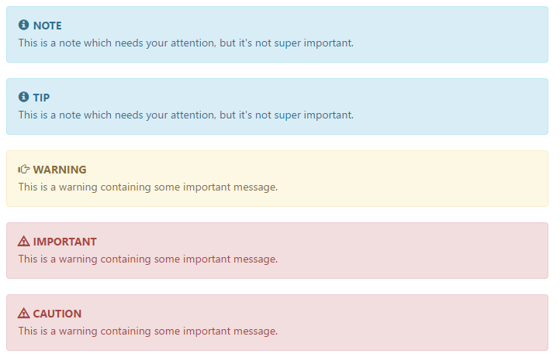
Rich Markdown Syntax
> [!NOTE]
> This is a note which needs your attention, but it's not super important.
>
> [!TIP]
> This is a note which needs your attention, but it's not super important.
>
> [!WARNING]
> This is a warning containing some important message.
>
> [!IMPORTANT]
> This is a warning containing some important message.
>
> [!CAUTION]
> This is a warning containing some important message.
Enriched blockquote

Slide 23
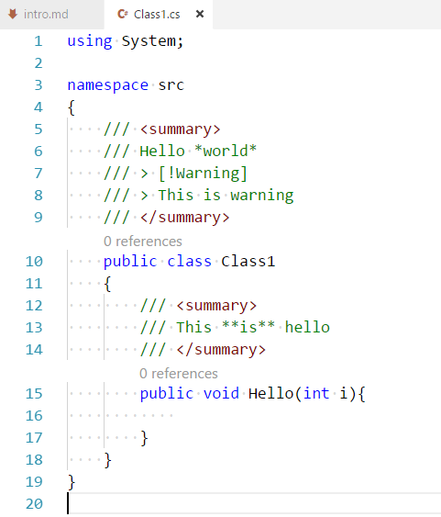
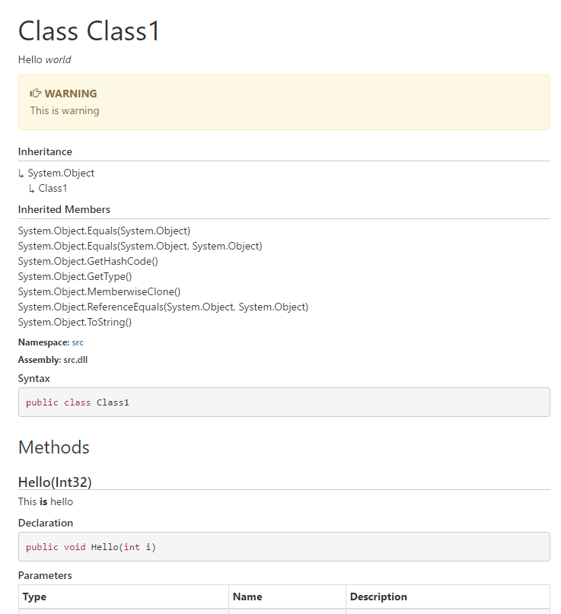
Rich Markdown syntax
Enriched blockquote in source code

Slide 24
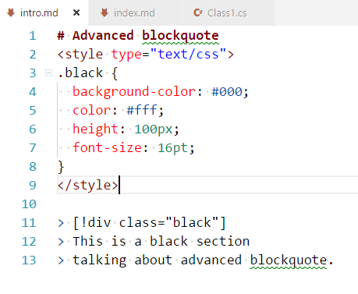
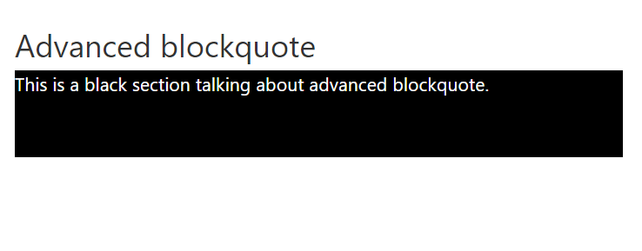
Rich Markdown syntax
Advanced blockquote

Slide 25
Rich Markdown Syntax
File Inclusion
[!include[<title>](<filepath>)]
Code Snippet Inclusion
[!code-csharp[Main](Program.cs)]
[!code[Main](Program.cs#L12-L16 "This is source file")]
[!code-vb[Main](../Application/Program.vb#testsnippet "This is source file")]
[!code[Main](index.xml?start=5&end=9)]
[!code-javascript[Main](../jquery.js?name=testsnippet)]
[!code[Main](index.xml?range=2,5-7,9-) "This includes the lines 2, 5, 6, 7 and lines 9 to the last line"]
[!code[Main](index.xml?highlight=2,5-7,9-) "This includes the whole file with lines 2,5-7,9- highlighted"]

Slide 26
Cross Reference
Reference files cross document types
From Markdown file to source code
From source code to Markdown file
Reference published files
Packages, e.g. MSDN.net45.rpk
http://dotnet.github.io/docfx/xrefmap.yml
Cross-reference RESTful API service (Coming)

Slide 27
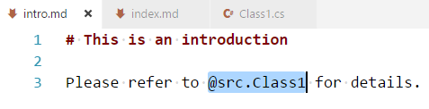
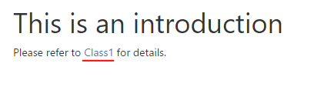
Cross Reference with @
Referencing source code
Link to a class

Slide 28
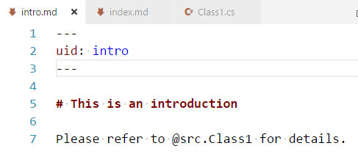
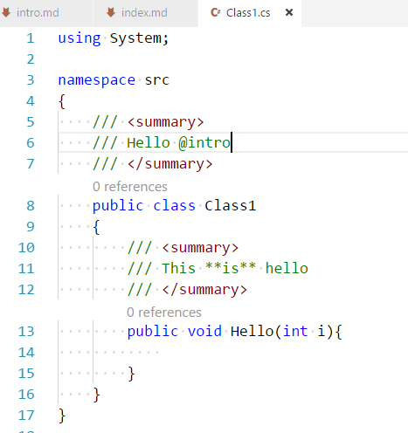
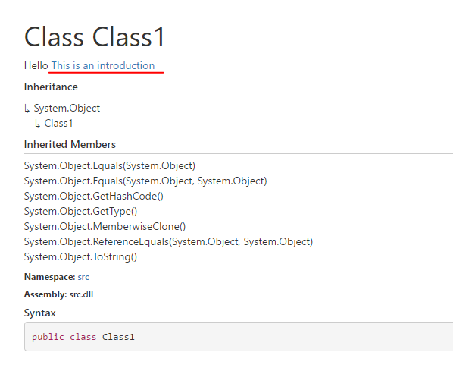
Cross Reference with @
Referencing Markdown file
[Introduction](../articles/intro.md)
Shortcut to Markdown file path
Define UID in YAML header

Slide 29
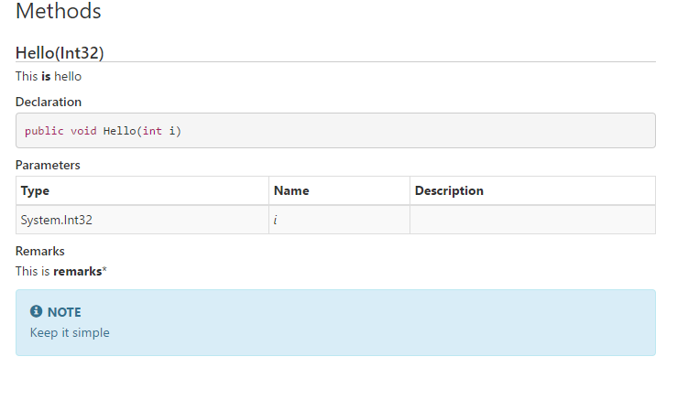
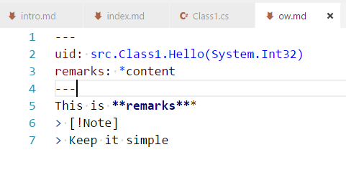
Overwrite document
Change the document without changing source code
Add remarks to the method

Slide 30
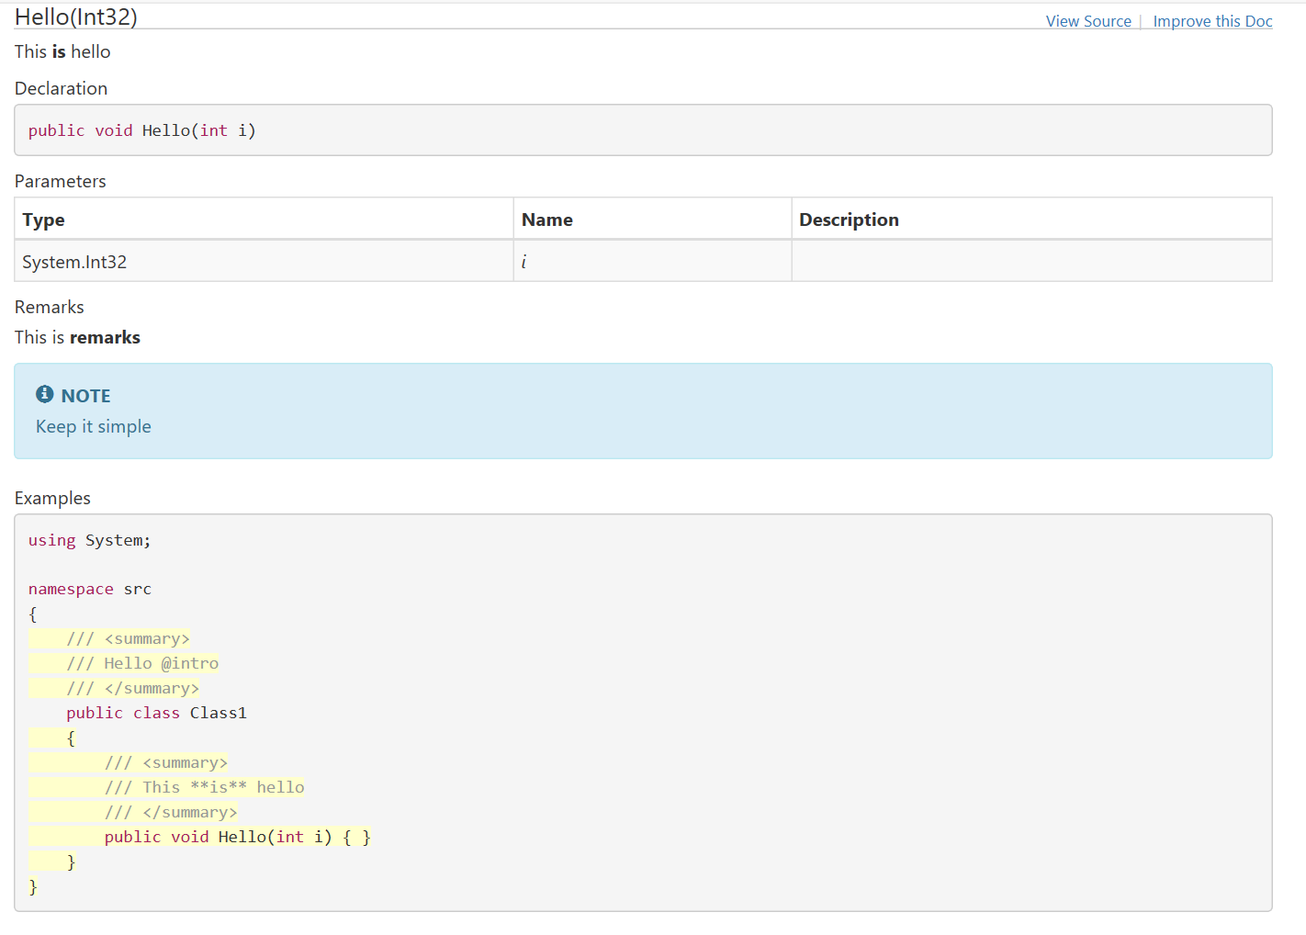
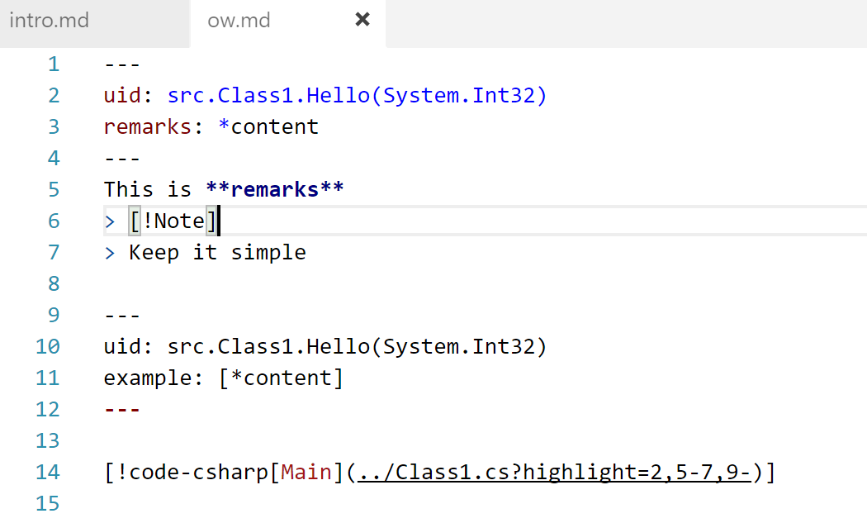
Overwrite document
Overwrite another property
Add example to the method

Slide 31
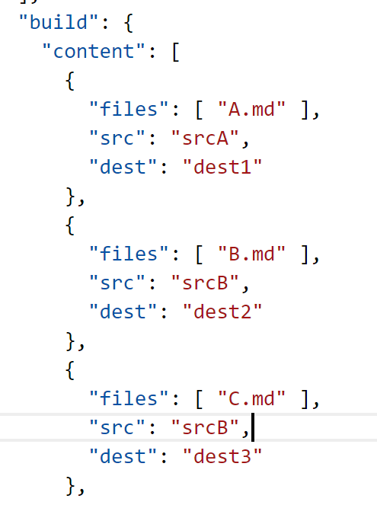


File layout restructure
DocFX calculates relative file links for you
srcA
srcB
dest1
dest2
dest3
../srcA/A.md
../srcB/C.md
../dest3/C.html

Slide 32
Multi-language support
Markdown
.NET language C#, VB
REST swagger.json file
Java (DOCS only)
Python (DOCS only)
Powershell (DOCS only)
….

Slide 33







Inside DocFX
Key principle for DocFX
input can always be mapped to data model
Inside DocFX
template
Input
model
model
N: M
Transform
1: N
template

Slide 34
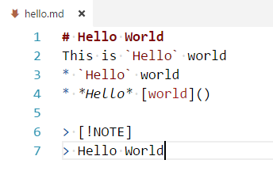
Inside DocFX
template
Input
model
model
N: M
Transform
1: N
template
Markdown file

Slide 35
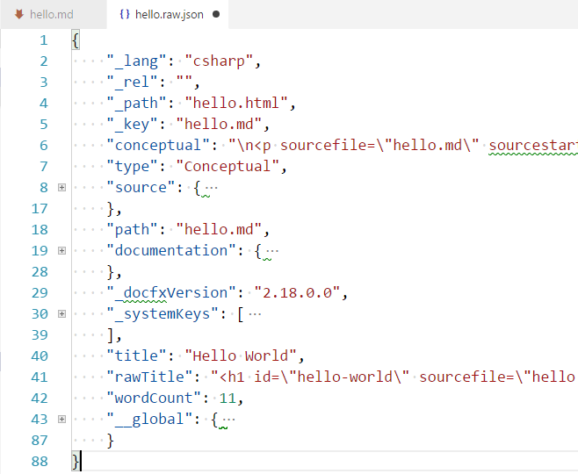
Inside DocFX
template
Input
model
model
N: M
Transform
1: N
template
Markdown file

Slide 36
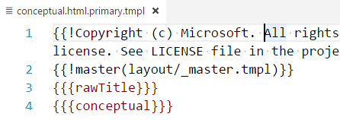
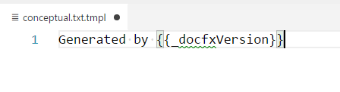
Inside DocFX
template
Input
model
model
N: M
Transform
1: N
template
hello.html
Markdown file
hello.txt

Slide 37
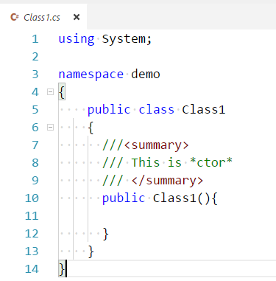
Inside DocFX
template
Input
model
model
N: M
Transform
1: N
template
C# Code

Slide 38
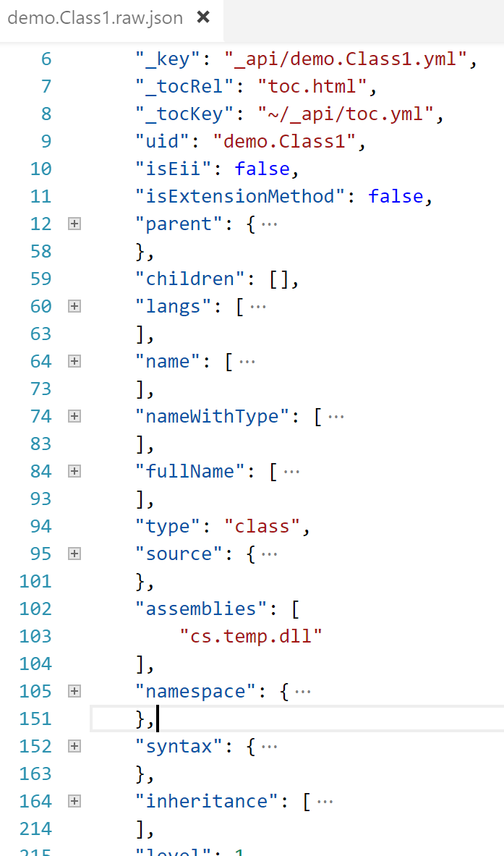
Inside DocFX
template
Input
model
model
N: M
Transform
1: N
template
C# Code

Slide 39
Inside DocFX
template
Input
model
model
N: M
Transform
1: N
template
ManagedReference.html.primary.tmpl
demo.Class1.html
C# Code
ManagedReference.mta.json.tmpl
demo.Class1.mta.json
ManagedReference.txt.tmpl
demo.Class1.txt

Slide 40
Inside DocFX
template
Input
model
model
M: N
Transform
1: N
template
Other languages
Can support any languages that
Can be mapped to a data model
Provide it’s corresponding template

Slide 41
Extensibility of DocFX
Inside DocFX
template
CI to prepare data
Input
model
model
M: N
Transform
1: N
1
template
Plugin to custom mapping
2
Plugin to custom transform
3
Custom Template

Slide 42
History
2015, POC project DocAsCode
Write document in a way similar to write code
Mainly focus on enhancement inside Visual Studio IDE
July 2015, change name to DocFX and join dotnet org
Focus on executable tool instead
Chosen as the document generator for OPS

Slide 43
History
Very first idea: Uses Razor Engine to generate html files
First website edition: AngularJS based Single Page Application
All the logic, including link resolver and markdown parser are in front-end JS
Cons: always need host service for routing, not work in GitHub pages

Slide 44
History
Approach to generate pure static website, no hosting required
Client
“iframe” for loading toc (obsoleted)
GitHub disabled “iframe” loading for security concerns
AJAX loading toc (default template)
toc.json/html can be cached
Toc embedded into the page for local file explore (statictoc template)

Slide 45
History
Approach to generate pure static website, no hosting required
Template
Mustache chosen, logic less, light-weighted template
Preprocessor introduced, to light-weight transformation to models, e.g. renaming
“require” syntax introduced for better local debugging experience using node.js
Cons: using Jint which only provides full CMA 5.1 compliance
Liquid supported
Model transformation is not that light-weighted
Using DotLiquid, not the original one, maintenance concerns

Slide 46
vNext
Schema base document processor
Support Razor template
More friendly to .NET developers
Watch features

Slide 47
Lessons learnt
“ It will grow ”

Slide 48
It will grow
Code
Code style with stylecop
Tracing and logging
Exception handler
Async programming model
Continuous Integration
build script
Appveyor, Jenkins,…
Documentation
Use DocFX ☺

Slide 49
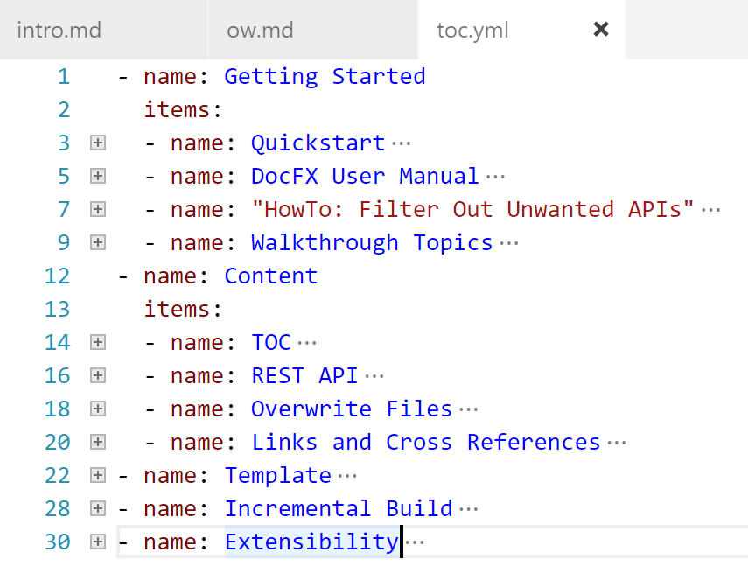
Design
Use Object model for contract
TOC model

Slide 50
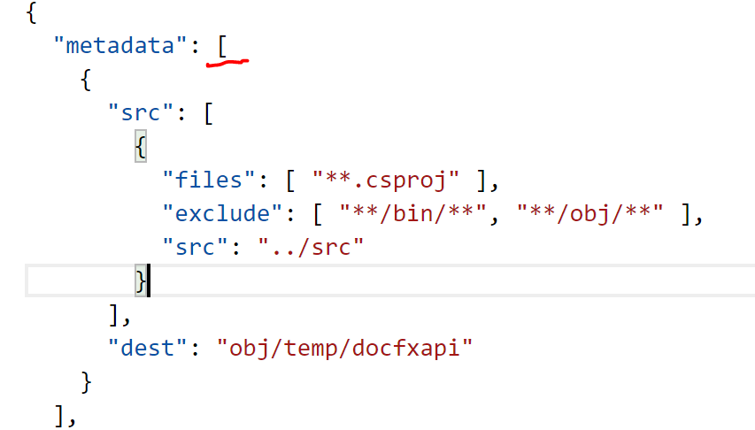
Design
Use Object model for contract
TOC model
docfx.json metadata section

Slide 51
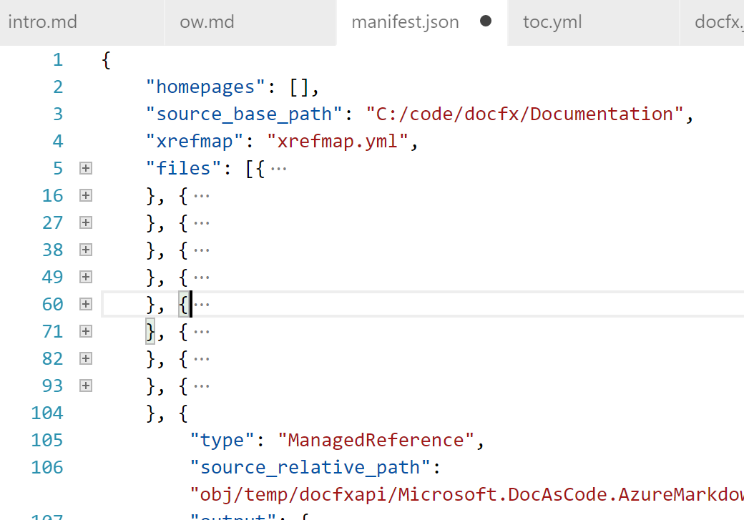
Design
Use Object model for contract
TOC model
docfx.json metadata section
Manifest file

Slide 52
Design
Understand your target community
docs.microsoft.com
Community users
Source code => website
Themes
Survey result from Feethub.com
20
docfx watch: serve rebuild file changes
8
More attractive themes
5
Website auto-build and host documents

Slide 53
Waiting for your pull requests
https://github.com/dotnet/docfx

